Slide 1
Project
File created on: 8/30/2023 11:29:58 AM

Slide 2
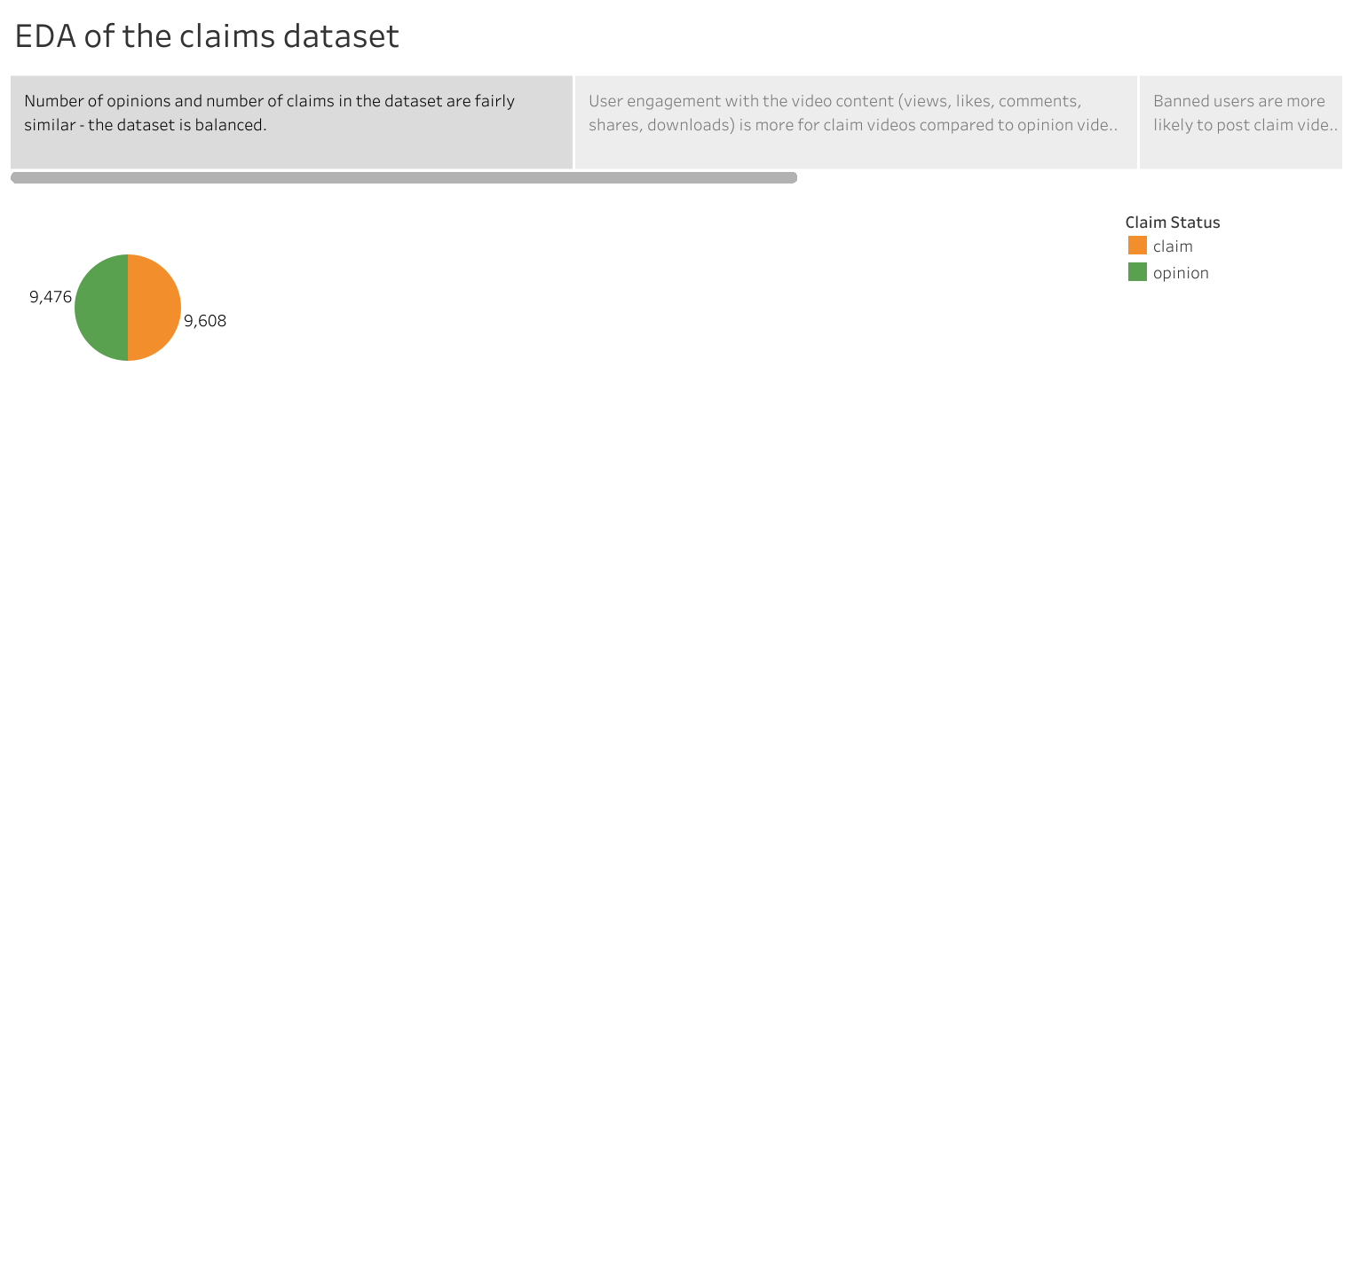

Slide 3
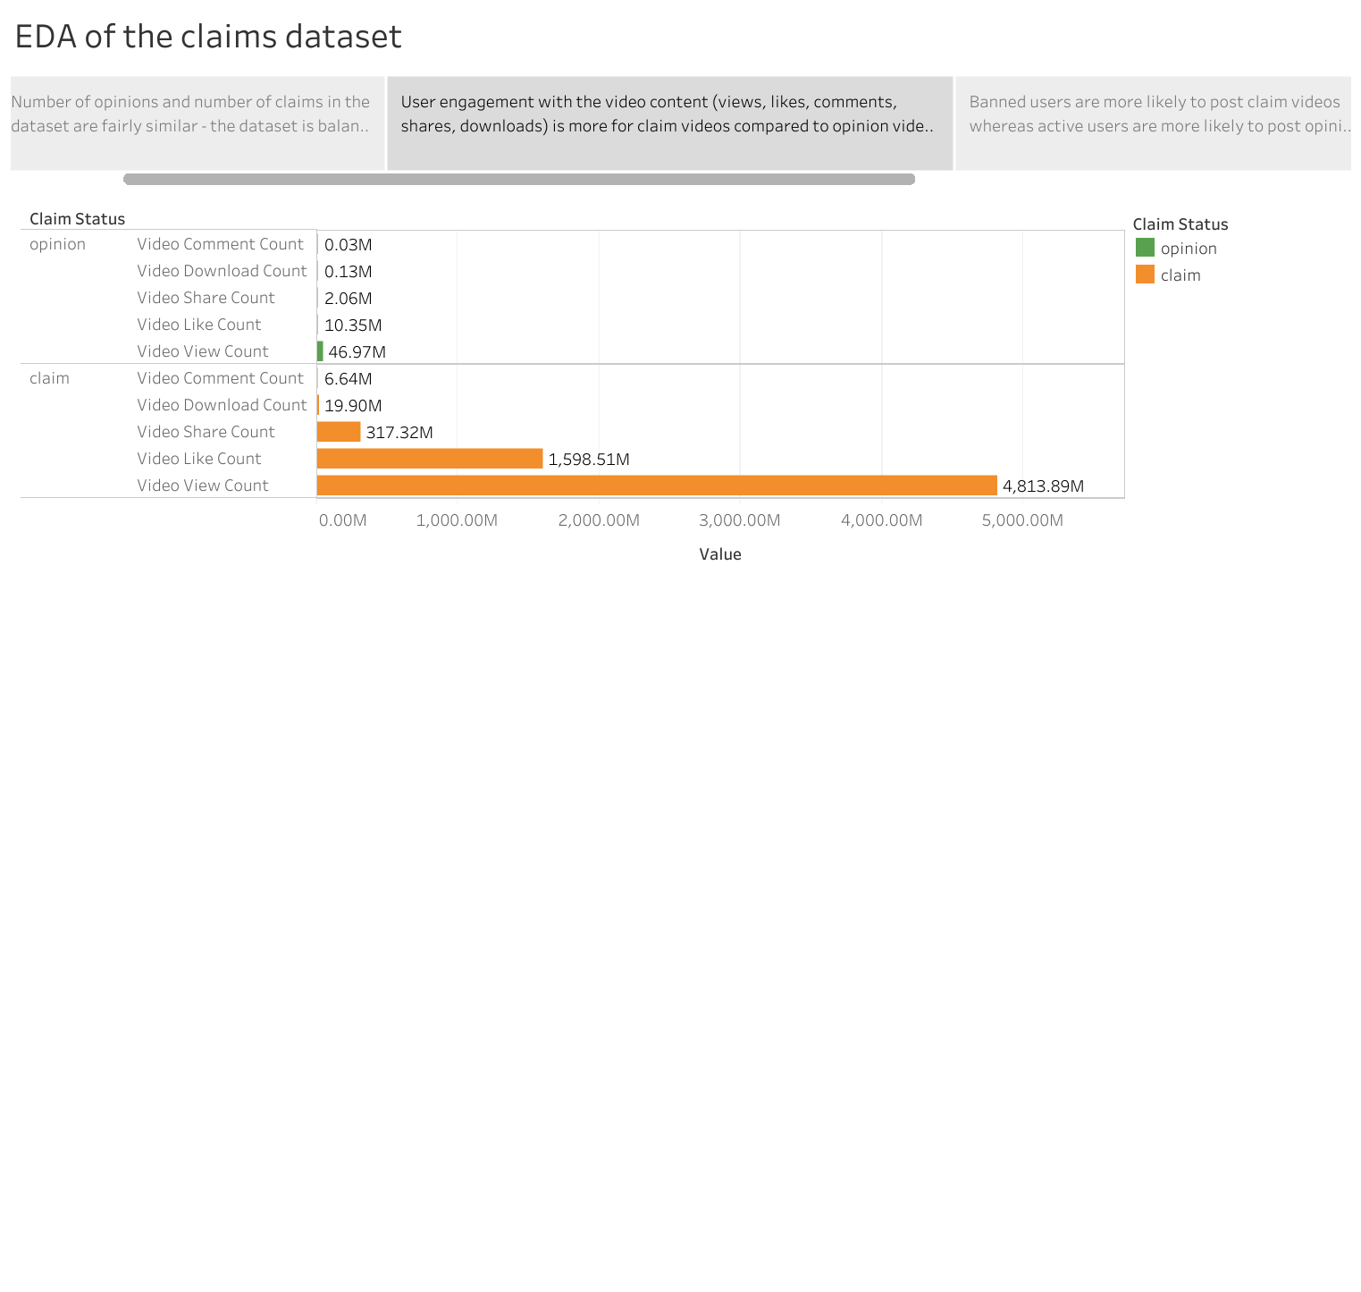

Slide 4
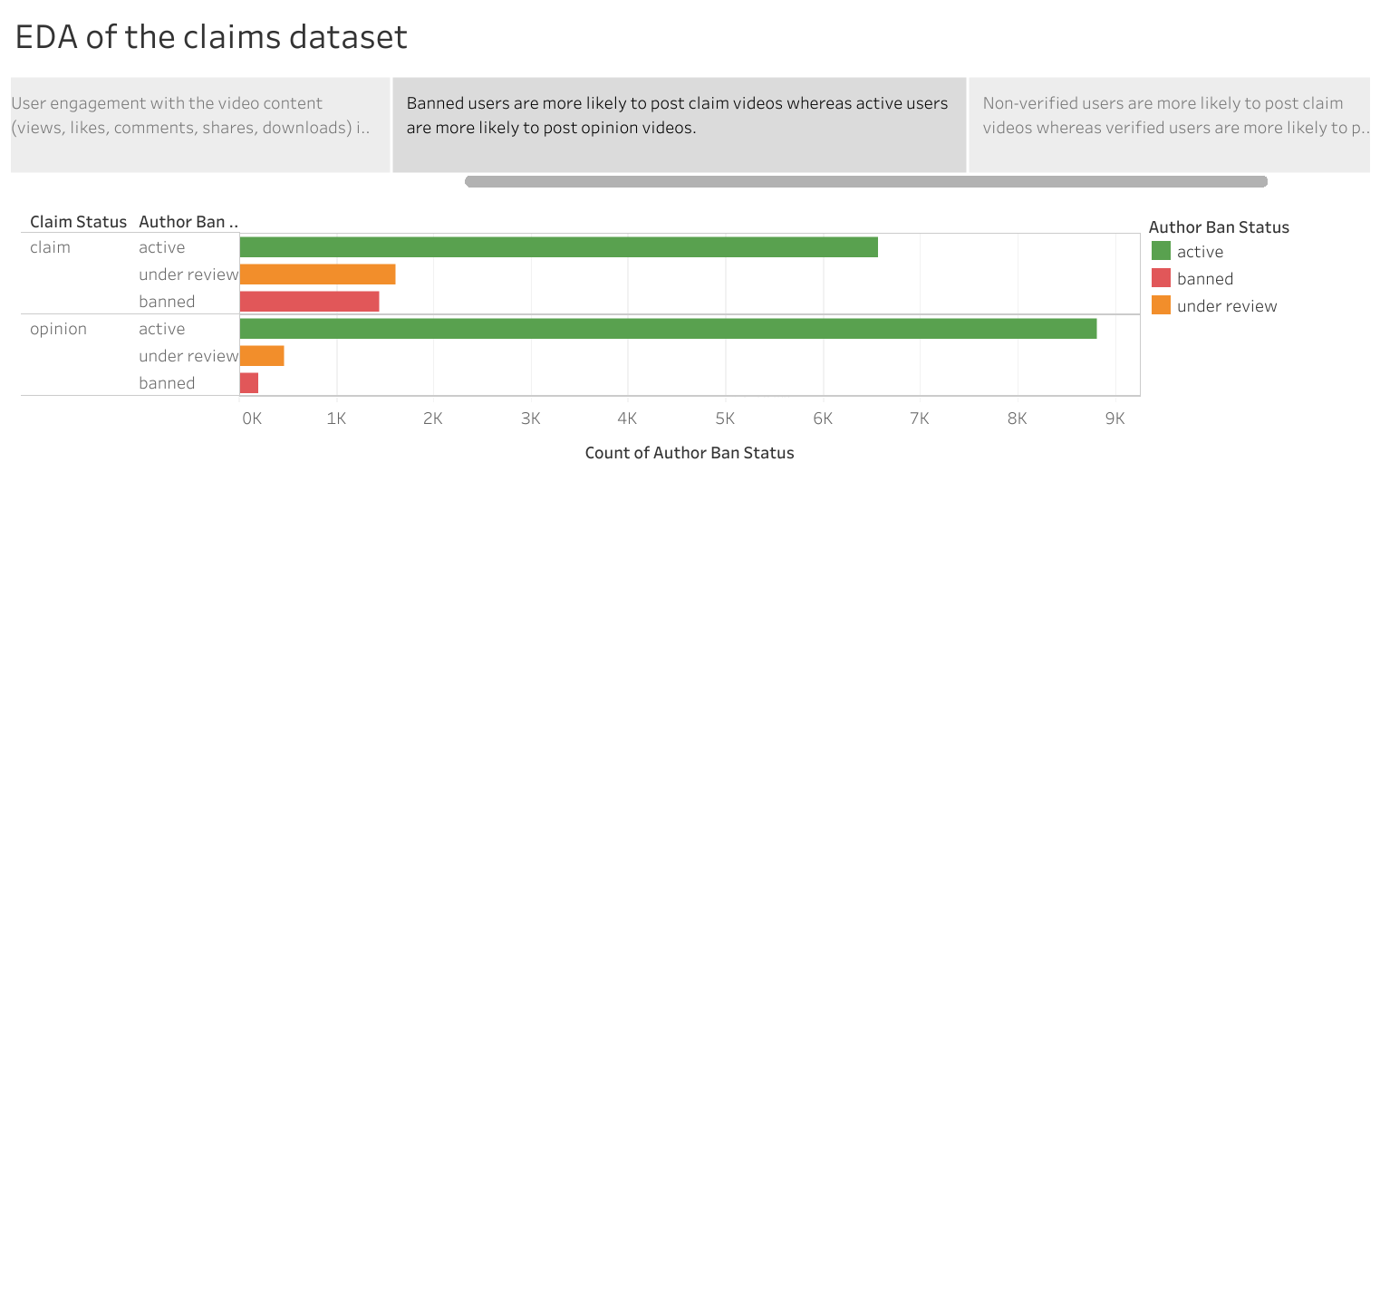

Slide 5
